Slide 1
Cours Android
cfa insta - promo 2021

Slide 2
Prérequis
Connaissance de base en programmation :
Variables, types, tableaux
Conditions
Boucles
Objets
interfaces
design pattern MVC
Android Studio : https://developer.android.com/studio/index.html

Slide 3
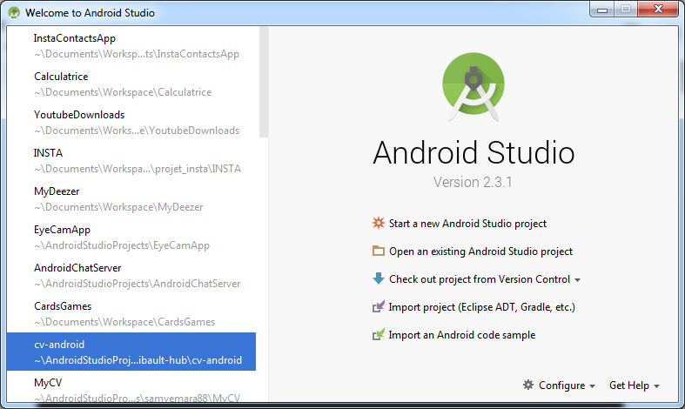
Android Studio

Slide 4
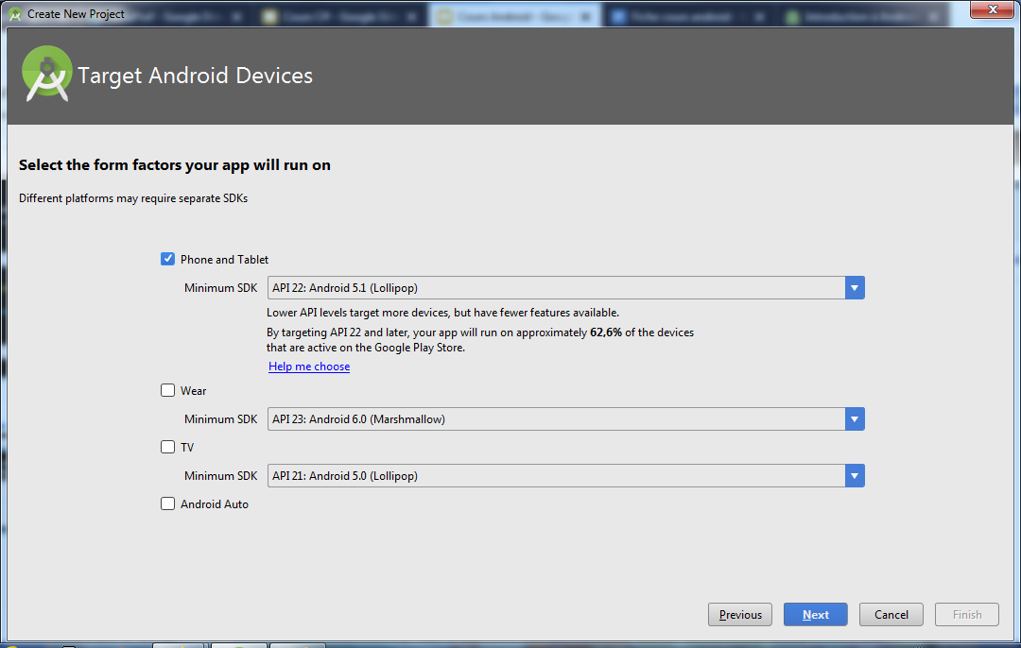
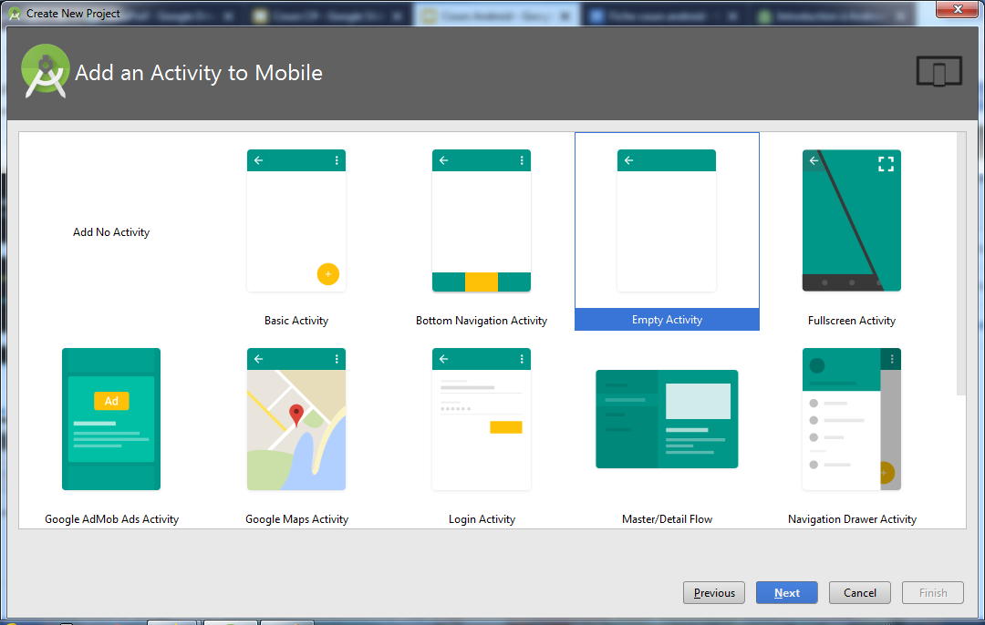
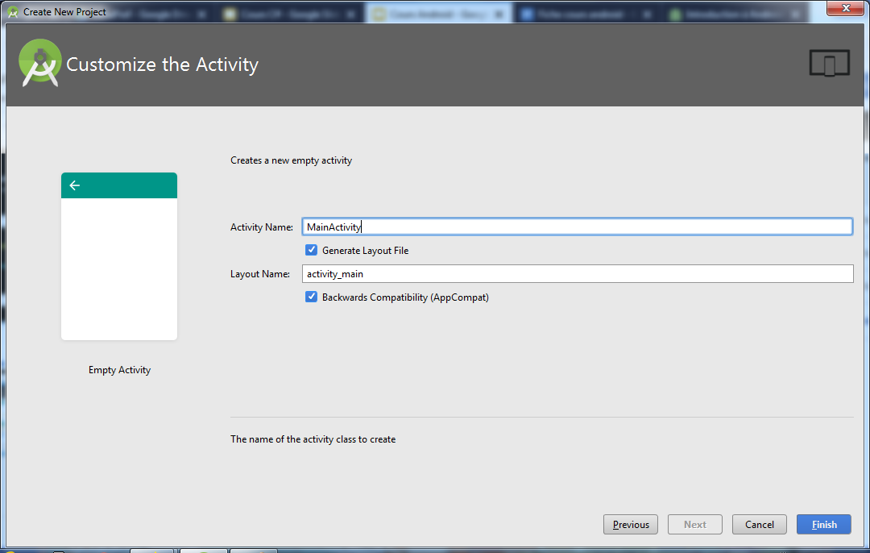
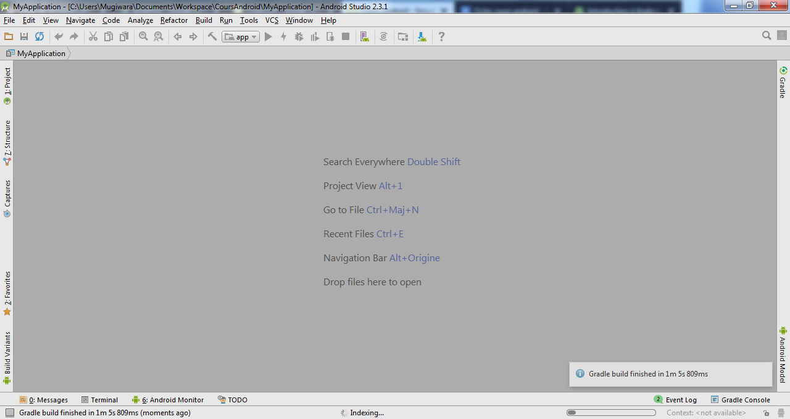
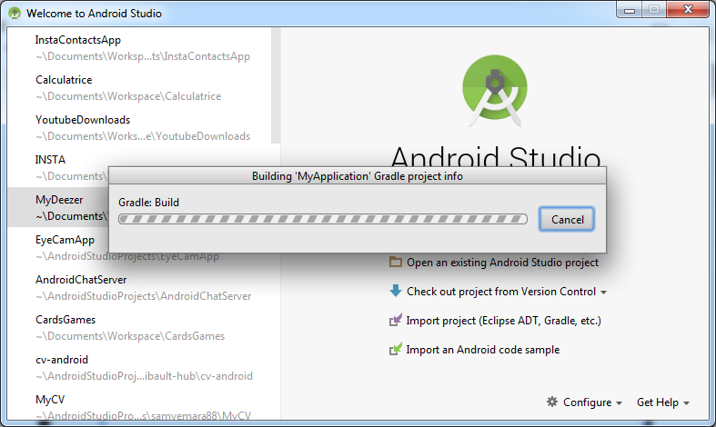
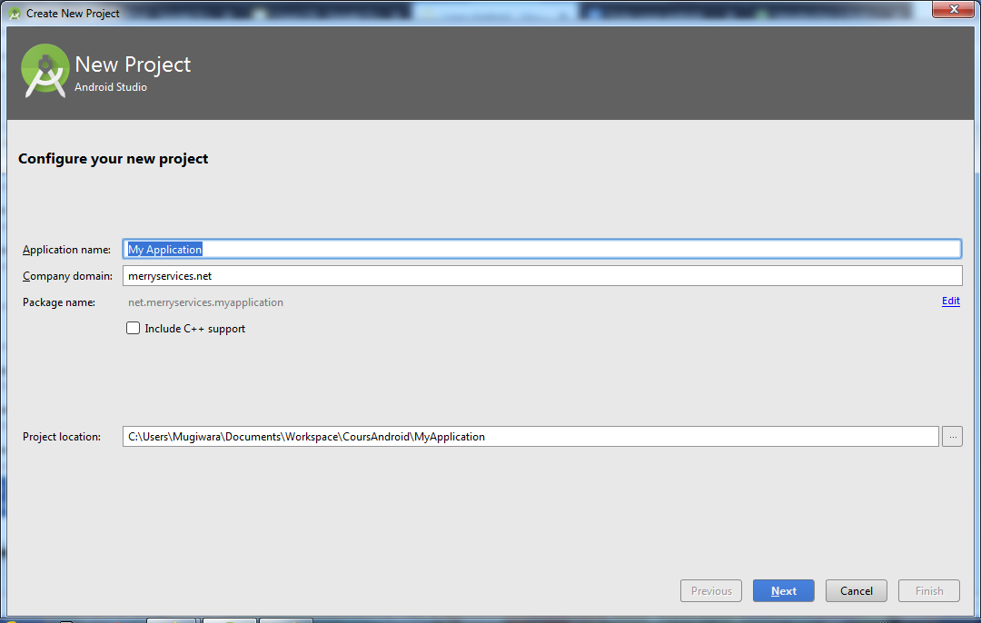
Android studio : Nouveau Projet

Slide 5
Android studio : outils
SDK manager :
gestionnaire de version des bibliothèques android.
avd manager:
gestion des appareils virtuels
(mobiles, tablettes, montres)

Slide 6
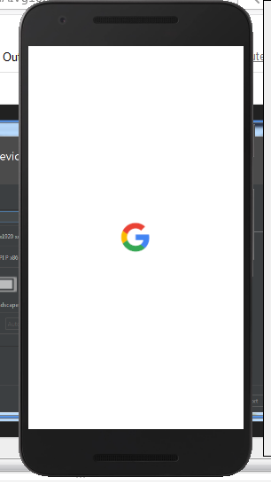
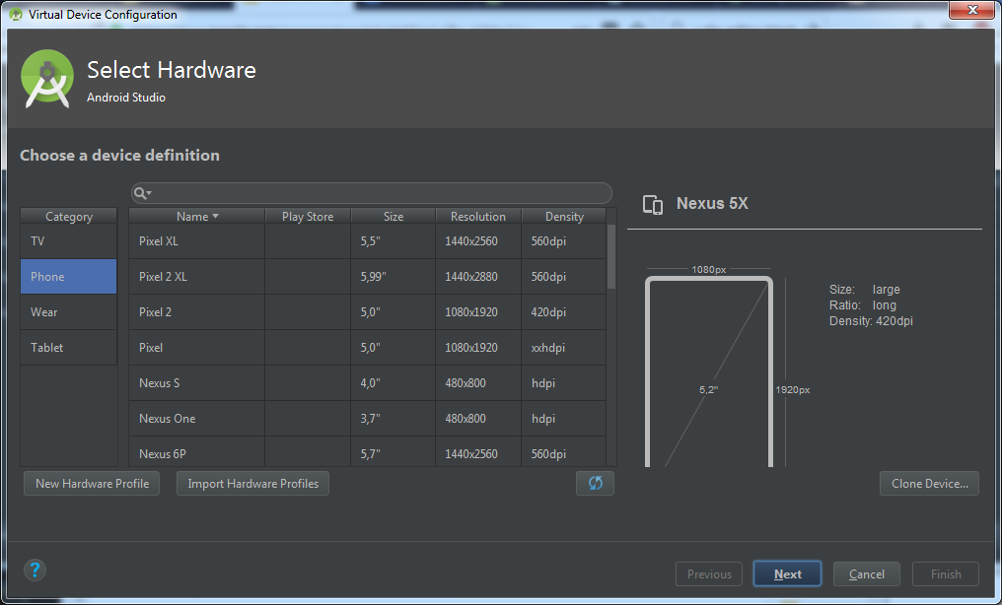
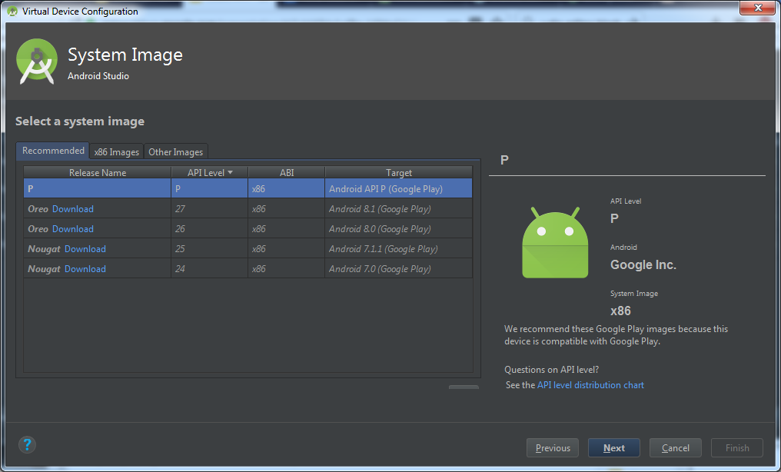
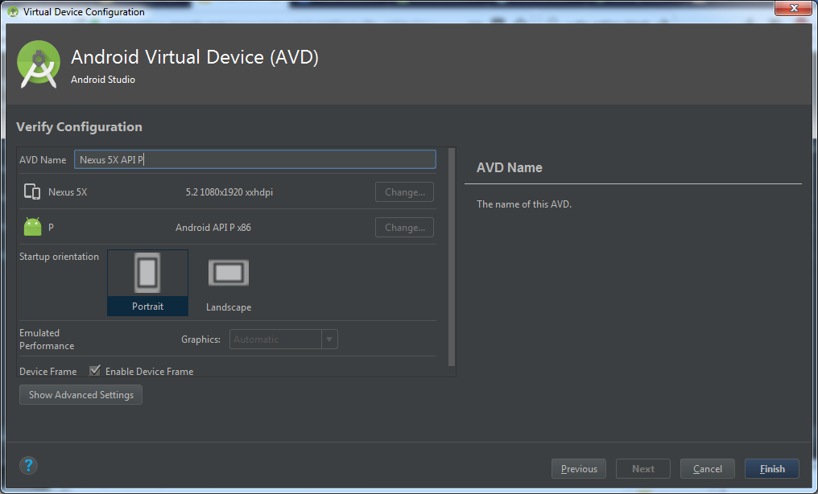
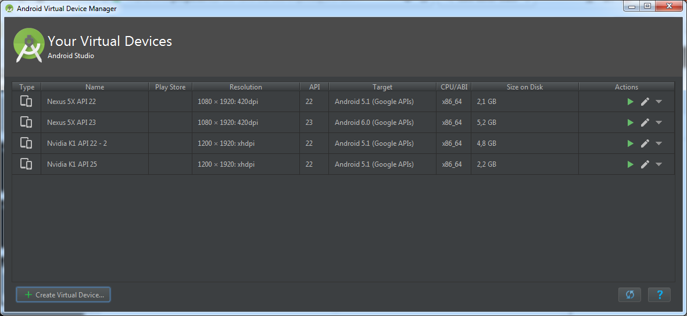
Android sdk : avd manager

Slide 7
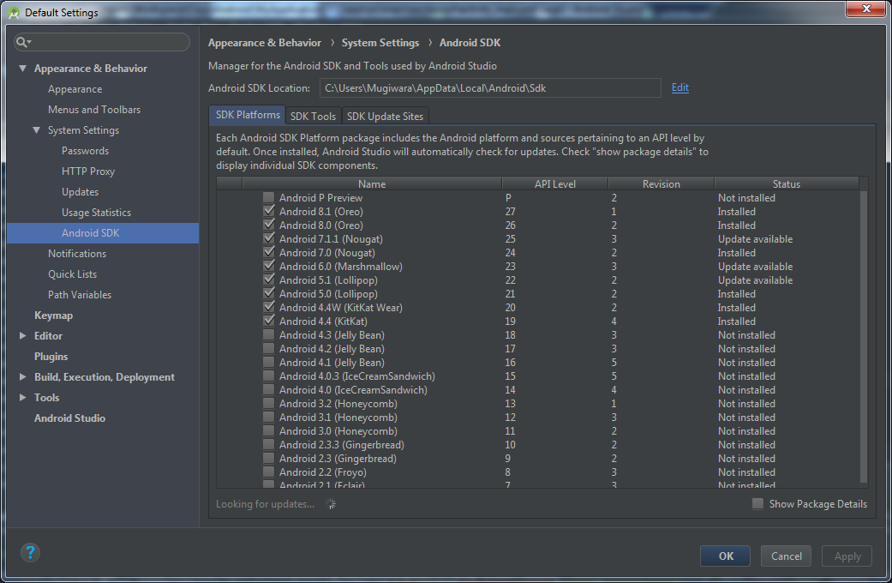
Android sdk : sdkmanager

Slide 8
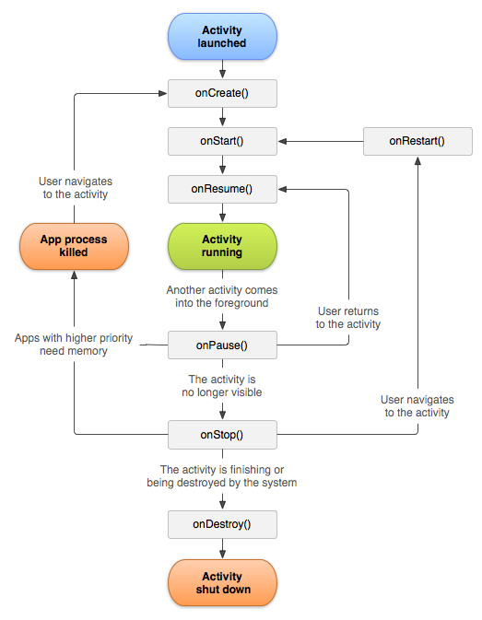
Android
Cycle de vie
d’une Activité

Slide 9
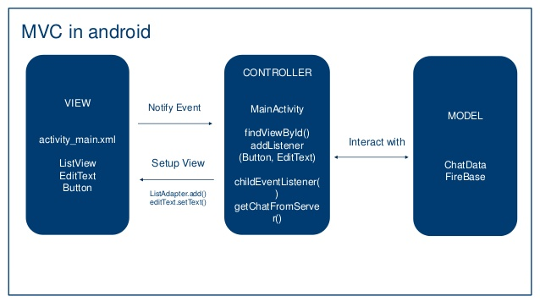
Android : Model MVC

Slide 10
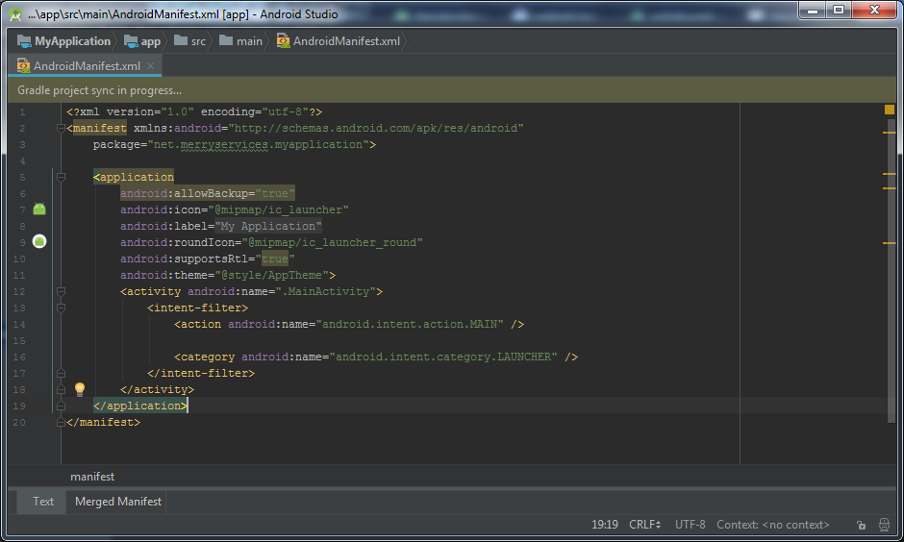
AndroidManifest.xml

Slide 11
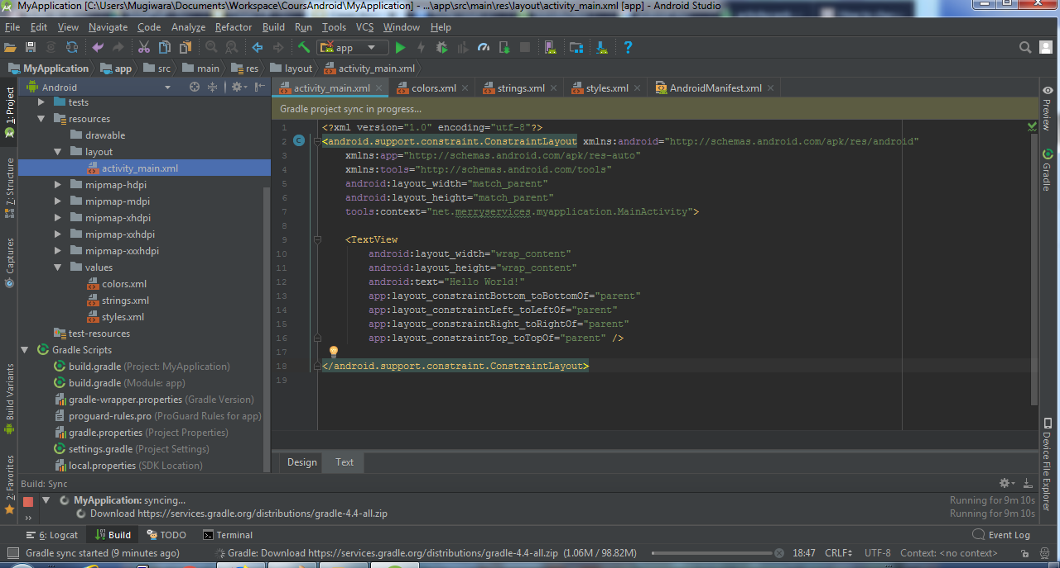
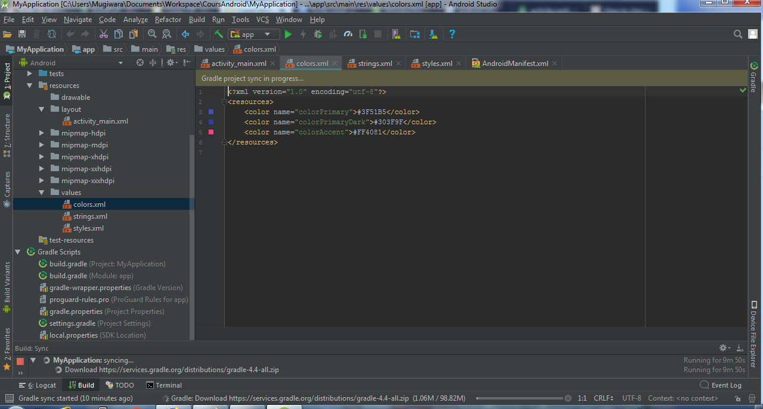
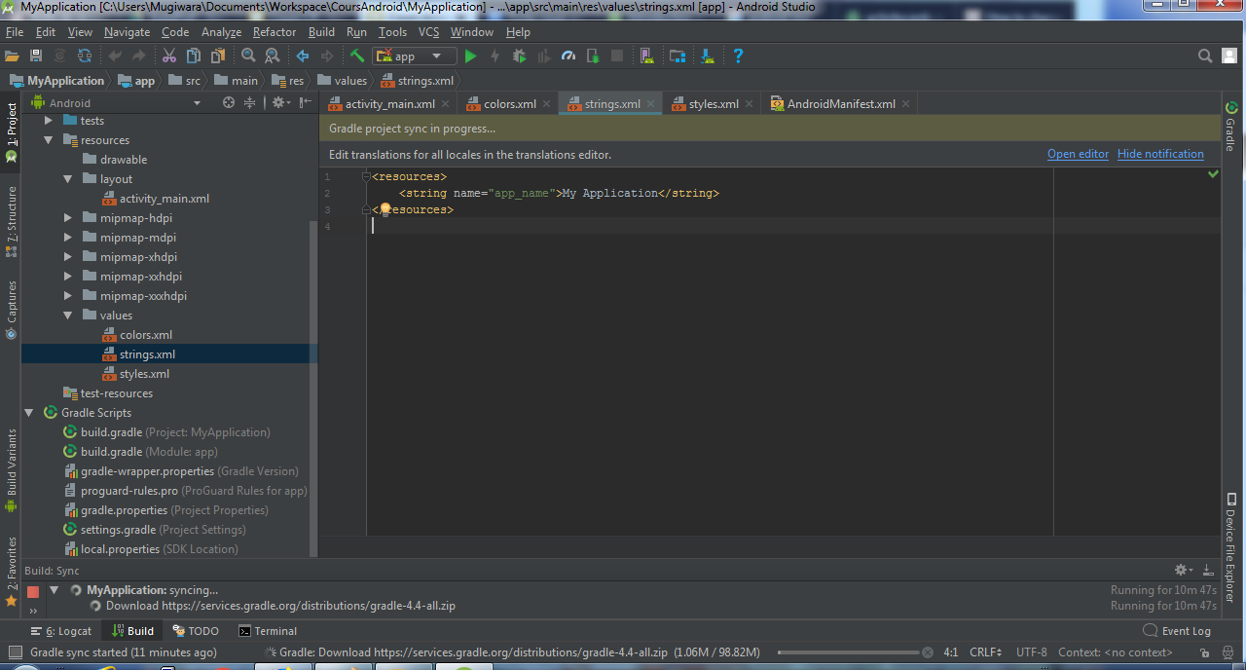
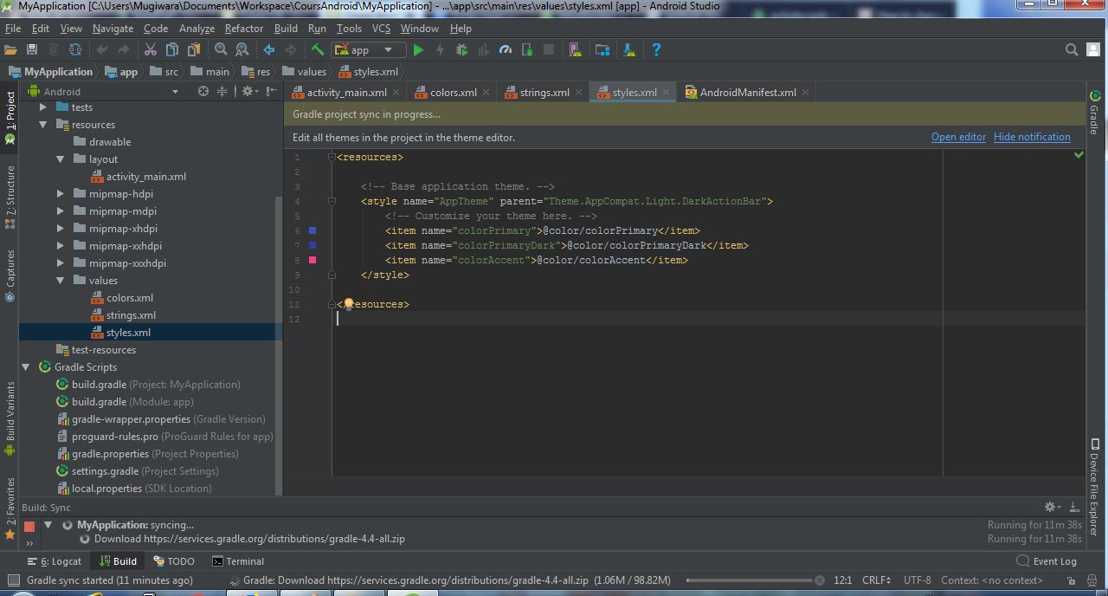
Android Resources

Slide 12
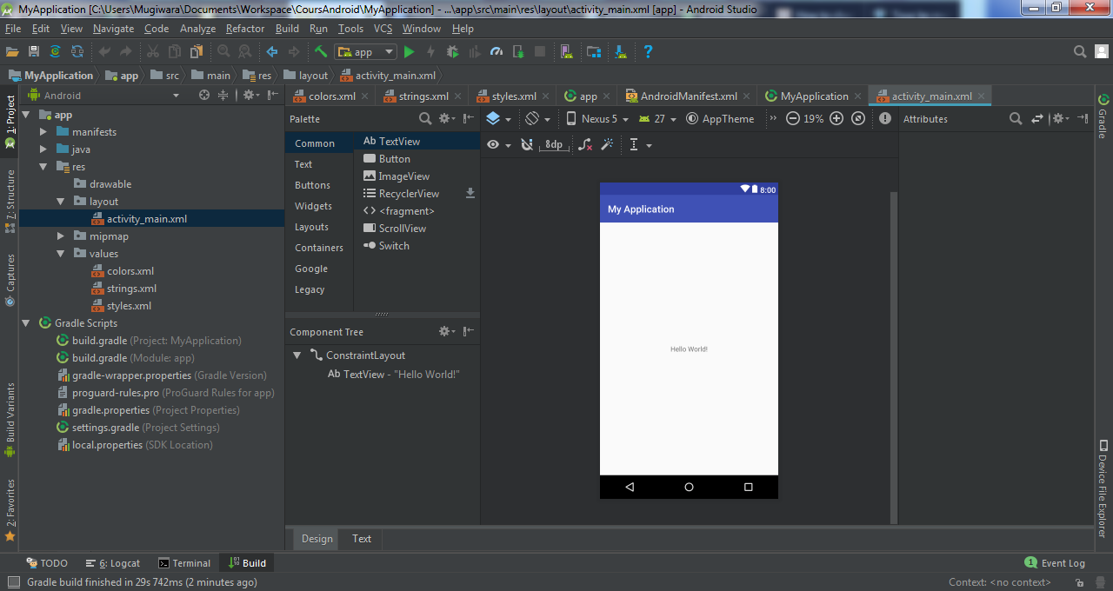
Android: éditeur de layout
Notes:
<?xml version="1.0" encoding="utf-8"?>
<LinearLayout xmlns:android="http://schemas.android.com/apk/res/android"
xmlns:app="http://schemas.android.com/apk/res-auto"
xmlns:tools="http://schemas.android.com/tools"
android:layout_width="match_parent"
android:layout_height="match_parent"
android:orientation="vertical"
tools:context=".MainActivity">
<TextView
android:layout_width="match_parent"
android:layout_height="wrap_content"
android:text="Contact details"
android:layout_margin="20dp"
android:padding="5dp"
android:textSize="24dp"
android:textColor="@android:color/holo_red_dark"
android:gravity="center"/>
<LinearLayout
android:layout_width="match_parent"
android:layout_height="wrap_content"
android:layout_marginHorizontal="20dp"
android:orientation="horizontal">
<TextView
android:layout_width="0dp"
android:layout_height="wrap_content"
android:layout_weight="1"
android:gravity="right"
android:textColor="@android:color/holo_red_dark"
android:layout_marginRight="5dp"
android:text="Nom :" />
<EditText
android:id="@+id/editTextName"
android:layout_width="0dp"
android:layout_height="wrap_content"
android:layout_weight="3"
android:ems="10"
android:inputType="textPersonName"
android:hint="Name"
android:enabled="false"/>
</LinearLayout>
<LinearLayout
android:layout_width="match_parent"
android:layout_height="wrap_content"
android:layout_marginHorizontal="20dp"
android:orientation="horizontal">
<TextView
android:layout_width="0dp"
android:layout_height="wrap_content"
android:layout_weight="1"
android:gravity="right"
android:textColor="@android:color/holo_red_dark"
android:layout_marginRight="5dp"
android:text="Prénom :" />
<EditText
android:id="@+id/editTextFirstname"
android:layout_width="0dp"
android:layout_height="wrap_content"
android:layout_weight="3"
android:ems="10"
android:inputType="textPersonName"
android:hint="Firstname"
android:enabled="false" />
</LinearLayout>
<LinearLayout
android:layout_width="match_parent"
android:layout_height="wrap_content"
android:layout_marginHorizontal="20dp"
android:orientation="horizontal">
<TextView
android:layout_width="0dp"
android:layout_height="wrap_content"
android:layout_weight="1"
android:gravity="right"
android:textColor="@android:color/holo_red_dark"
android:layout_marginRight="5dp"
android:text="Mail :" />
<EditText
android:id="@+id/editTextMail"
android:layout_width="0dp"
android:layout_height="wrap_content"
android:layout_weight="3"
android:ems="10"
android:inputType="textEmailAddress"
android:hint="EMAIL"
android:enabled="false" />
</LinearLayout>
<LinearLayout
android:layout_width="match_parent"
android:layout_height="wrap_content"
android:layout_marginHorizontal="20dp"
android:orientation="horizontal">
<TextView
android:layout_width="0dp"
android:layout_height="wrap_content"
android:layout_weight="1"
android:gravity="right"
android:textColor="@android:color/holo_red_dark"
android:layout_marginRight="5dp"
android:text="Mobile :" />
<EditText
android:id="@+id/editTextMobile"
android:layout_width="0dp"
android:layout_height="wrap_content"
android:layout_weight="3"
android:ems="10"
android:inputType="phone"
android:hint="06..."
android:enabled="false"/>
</LinearLayout>
<LinearLayout
android:layout_width="match_parent"
android:layout_height="wrap_content"
android:layout_margin="20dp"
android:orientation="horizontal">
<Button
android:id="@+id/buttonCancel"
android:layout_width="wrap_content"
android:layout_height="wrap_content"
android:layout_weight="1"
android:layout_marginRight="5dp"
android:visibility="invisible"
android:text="Cancel" />
<Button
android:id="@+id/buttonSave"
android:layout_width="wrap_content"
android:layout_height="wrap_content"
android:layout_weight="1"
android:text="Edit" />
</LinearLayout>
</LinearLayout>

Slide 13
Android: éditeur de layout
Notes:
package com.example.contacts;
public class Contact {
private String name;
private String firstname;
private String email;
private String mobile;
public Contact(String name, String firstname, String email, String mobile) {
this.name = name;
this.firstname = firstname;
this.email = email;
this.mobile = mobile;
}
public String getName() {
return name;
}
public void setName(String name) {
this.name = name;
}
public String getFirstname() {
return firstname;
}
public void setFirstname(String firstname) {
this.firstname = firstname;
}
public String getEmail() {
return email;
}
public void setEmail(String email) {
this.email = email;
}
public String getMobile() {
return mobile;
}
public void setMobile(String mobile) {
this.mobile = mobile;
}
}

Slide 14
Android: éditeur de layout
Notes:
package com.example.contacts;
import androidx.appcompat.app.AppCompatActivity;
import android.os.Bundle;
import android.view.View;
import android.widget.Button;
import android.widget.EditText;
public class MainActivity extends AppCompatActivity {
EditText editTextName, editTextFirstname, editTextMail, editTextMobile;
Button buttonCancel, buttonSave;
@Override
protected void onCreate(Bundle savedInstanceState) {
super.onCreate(savedInstanceState);
setContentView(R.layout.activity_main);
editTextName= (EditText) findViewById(R.id.editTextName);
editTextFirstname= (EditText) findViewById(R.id.editTextFirstname);
editTextMail= (EditText) findViewById(R.id.editTextMail);
editTextMobile= (EditText) findViewById(R.id.editTextMobile);
buttonCancel = (Button) findViewById(R.id.buttonCancel);
buttonSave = (Button) findViewById(R.id.buttonSave);
buttonSave.setOnClickListener(new View.OnClickListener() {
@Override
public void onClick(View v) {
buttonCancel.setVisibility(View.VISIBLE);
buttonSave.setText("Save");
editTextName.setEnabled(true);
editTextFirstname.setEnabled(true);
editTextMail.setEnabled(true);
editTextMobile.setEnabled(true);
}
});
Contact contact= new Contact("François", "Joan",
"j.francois@cfa-insta.fr","0633763367");
editTextName.setText(contact.getName());
editTextFirstname.setText(contact.getFirstname());
editTextMail.setText(contact.getEmail());
editTextMobile.setText(contact.getMobile());
}
}

Slide 15
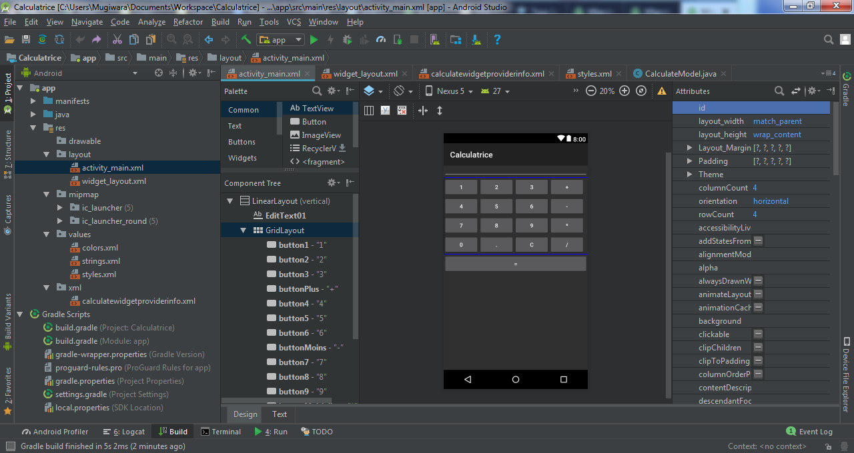
Calculatrice

Slide 16
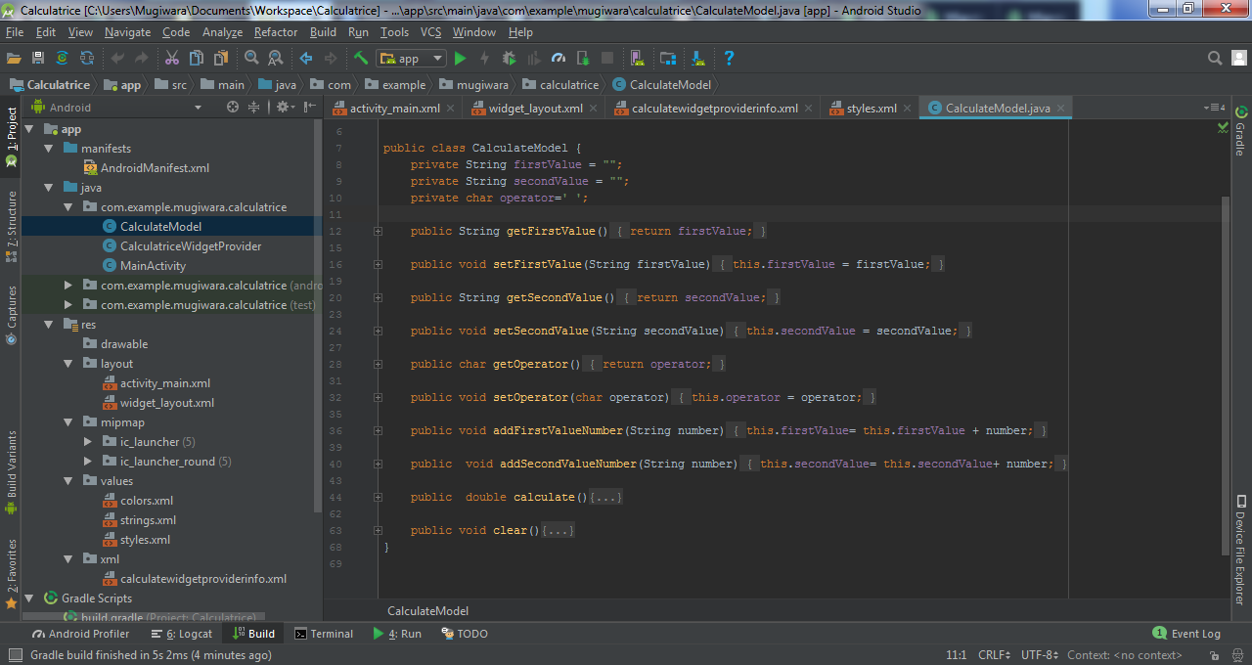
Calculatrice: model

Slide 17
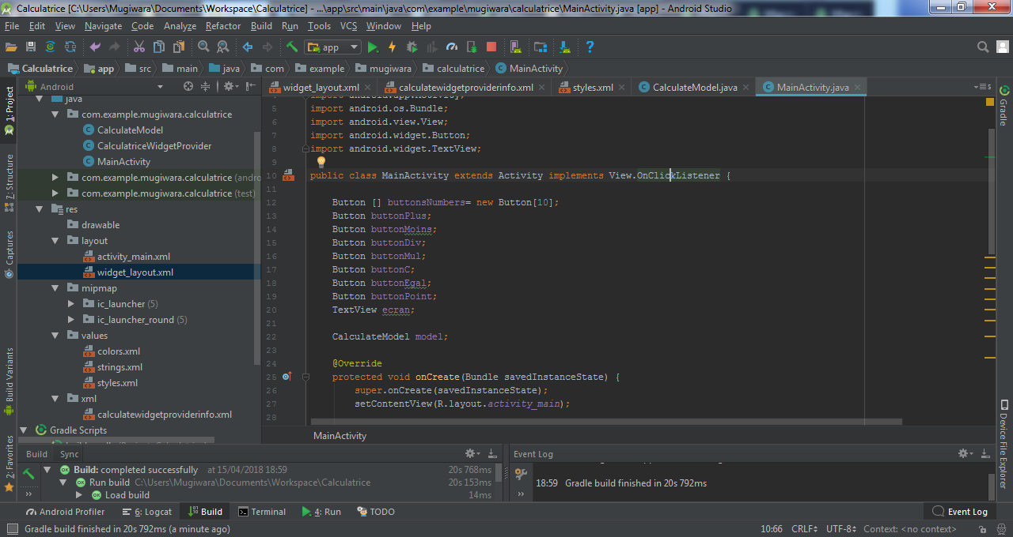
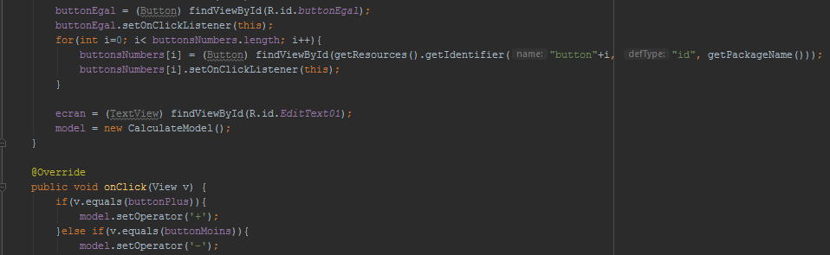
Calculatrice: controller

Slide 18
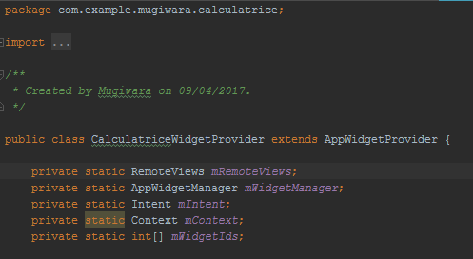
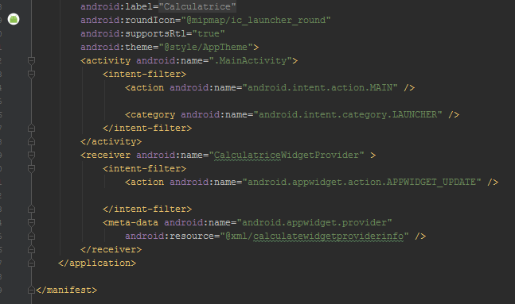
Calculatrice : Widget
Notes:
public class CalculatriceWidgetProvider extends AppWidgetProvider {
private static RemoteViews mRemoteViews;
private static AppWidgetManager mWidgetManager;
private static Intent mIntent;
private static Context mContext;
private static int[] mWidgetIds;
private final static String ACTION_PLUS= "+";
private final static String ACTION_MOINS= "-";
private final static String ACTION_DIV= "/";
private final static String ACTION_MUL= "*";
private final static String ACTION_ClEAR= "C";
private final static String ACTION_POINT= ".";
private final static String ACTION_EGAL= "=";
private final static String ACTION_0= "0";
private final static String ACTION_1= "1";
private final static String ACTION_2= "2";
private final static String ACTION_3= "3";
private final static String ACTION_4= "4";
private final static String ACTION_5= "5";
private final static String ACTION_6= "6";
private final static String ACTION_7= "7";
private final static String ACTION_8= "8";
private final static String ACTION_9= "9";
private static CalculateModel model;
@Override
public void onUpdate(Context context, AppWidgetManager appWidgetManager, int[] appWidgetIds) {
initVariables(context);
mIntent = new Intent(context, CalculatriceWidgetProvider.class);
setupIntent(ACTION_PLUS, R.id.buttonPlus);
setupIntent(ACTION_MOINS, R.id.buttonMoins);
setupIntent(ACTION_MUL, R.id.buttonMultiplier);
setupIntent(ACTION_DIV, R.id.buttonDivision);
setupIntent(ACTION_ClEAR, R.id.buttonC);
setupIntent(ACTION_POINT, R.id.buttonPoint);
setupIntent(ACTION_EGAL, R.id.buttonEgal);
for(int i=0; i < 10 ; i++) {
setupIntent(String.valueOf(i), context.getResources().getIdentifier("button" + i, "id", context.getPackageName()));
}
updateWidget();
super.onUpdate(context, appWidgetManager, appWidgetIds);
}
@Override
public void onReceive(Context context, Intent intent) {
final String action = intent.getAction();
switch (action) {
case ACTION_PLUS:
case ACTION_MOINS:
case ACTION_MUL:
case ACTION_DIV:
case ACTION_ClEAR:
case ACTION_POINT:
case ACTION_EGAL:
case ACTION_0:
case ACTION_1:
case ACTION_2:
case ACTION_3:
case ACTION_4:
case ACTION_5:
case ACTION_6:
case ACTION_7:
case ACTION_8:
case ACTION_9:
myAction(action, context);
break;
default:
super.onReceive(context, intent);
}
}
private void myAction(String action, Context context) {
if (model == null || mRemoteViews == null || mWidgetManager == null || mContext == null) {
initVariables(context);
}
switch (action){
case ACTION_PLUS:
case ACTION_MOINS:
case ACTION_MUL:
case ACTION_DIV:
model.setOperator(action.charAt(0));
break;
case ACTION_ClEAR:
model.clear();
mRemoteViews.setTextViewText(R.id.EditText01, "0");
updateWidget();
break;
case ACTION_EGAL:
double result = model.calculate();
mRemoteViews.setTextViewText(R.id.EditText01, String.valueOf(result));
model.clear();
model.setFirstValue(String.valueOf(result));
updateWidget();
break;
default:
if(model.getOperator() == ' '){
model.addFirstValueNumber(action);
mRemoteViews.setTextViewText(R.id.EditText01, model.getFirstValue());
}else{
model.addSecondValueNumber(action);
mRemoteViews.setTextViewText(R.id.EditText01, model.getSecondValue());
}
updateWidget();
break;
}
}
private void setupIntent(String action, int id) {
mIntent.setAction(action);
PendingIntent pendingIntent = PendingIntent.getBroadcast(mContext, 0, mIntent, 0);
mRemoteViews.setOnClickPendingIntent(id, pendingIntent);
}
private void initVariables(Context context){
mContext = context;
updateWidgetIds();
mRemoteViews = new RemoteViews(mContext.getPackageName(), R.layout.widget_layout);
mWidgetManager = AppWidgetManager.getInstance(mContext);
model = new CalculateModel();
}
private void updateWidget() {
for (int widgetId : mWidgetIds) {
mWidgetManager.updateAppWidget(widgetId, mRemoteViews);
}
}
private void updateWidgetIds() {
final ComponentName component = new ComponentName(mContext, CalculatriceWidgetProvider.class);
mWidgetManager = AppWidgetManager.getInstance(mContext);
mWidgetIds = mWidgetManager.getAppWidgetIds(component);
}
@Override
public void onDeleted(Context context, int[] appWidgetIds) {
super.onDeleted(context, appWidgetIds);
if (mContext != null)
updateWidgetIds();
}
}

Slide 19
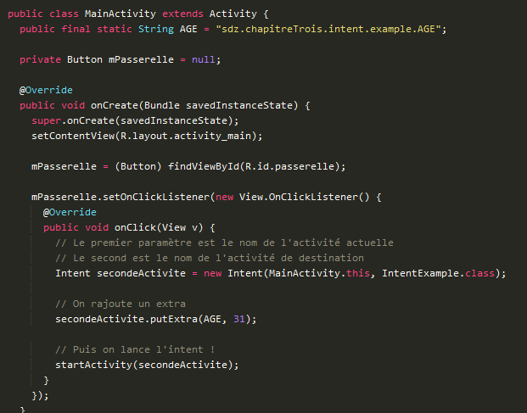
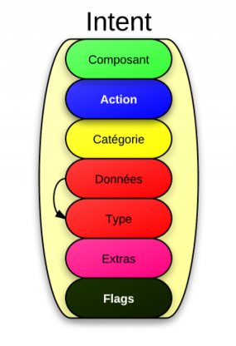
Intents
Notes:
<?xml version="1.0" encoding="utf-8"?>
<LinearLayout xmlns:android="http://schemas.android.com/apk/res/android"
android:orientation="vertical"
android:layout_width="fill_parent"
android:layout_height="fill_parent"
>
<TextView android:id="@+id/EditText01"
android:layout_width="fill_parent"
android:layout_height="wrap_content"
android:textSize="24sp"
android:editable="false"
android:cursorVisible="false"
android:text="0"
/>
<LinearLayout xmlns:android="http://schemas.android.com/apk/res/android"
android:orientation="horizontal"
android:layout_width="fill_parent"
android:layout_height="wrap_content"
>
<Button android:id="@+id/button1"
android:text="1"
android:layout_width="fill_parent"
android:layout_height="wrap_content"
android:layout_weight="1"
/>
<Button android:id="@+id/button2"
android:text="2"
android:layout_width="fill_parent"
android:layout_height="wrap_content"
android:layout_weight="1"
/>
<Button android:id="@+id/button3"
android:text="3"
android:layout_width="fill_parent"
android:layout_height="wrap_content"
android:layout_weight="1"
/>
<Button android:id="@+id/buttonPlus"
android:text="+"
android:layout_width="fill_parent"
android:layout_height="wrap_content"
android:layout_weight="1"
/>
</LinearLayout>
<LinearLayout xmlns:android="http://schemas.android.com/apk/res/android"
android:orientation="horizontal"
android:layout_width="fill_parent"
android:layout_height="wrap_content"
>
<Button android:id="@+id/button4"
android:text="4"
android:layout_width="fill_parent"
android:layout_height="wrap_content"
android:layout_weight="1"
/>
<Button android:id="@+id/button5"
android:text="5"
android:layout_width="fill_parent"
android:layout_height="wrap_content"
android:layout_weight="1"
/>
<Button android:id="@+id/button6"
android:text="6"
android:layout_width="fill_parent"
android:layout_height="wrap_content"
android:layout_weight="1"
/>
<Button android:id="@+id/buttonMoins"
android:text="-"
android:layout_width="fill_parent"
android:layout_height="wrap_content"
android:layout_weight="1"
/>
</LinearLayout>
<LinearLayout xmlns:android="http://schemas.android.com/apk/res/android"
android:orientation="horizontal"
android:layout_width="fill_parent"
android:layout_height="wrap_content"
>
<Button android:id="@+id/button7"
android:text="7"
android:layout_width="fill_parent"
android:layout_height="wrap_content"
android:layout_weight="1"
/>
<Button android:id="@+id/button8"
android:text="8"
android:layout_width="fill_parent"
android:layout_height="wrap_content"
android:layout_weight="1"
/>
<Button android:id="@+id/button9"
android:text="9"
android:layout_width="fill_parent"
android:layout_height="wrap_content"
android:layout_weight="1"
/>
<Button android:id="@+id/buttonMultiplier"
android:text="*"
android:layout_width="fill_parent"
android:layout_height="wrap_content"
android:layout_weight="1"
/>
</LinearLayout>
<LinearLayout xmlns:android="http://schemas.android.com/apk/res/android"
android:orientation="horizontal"
android:layout_width="fill_parent"
android:layout_height="wrap_content"
>
<Button android:id="@+id/button0"
android:text="0"
android:layout_width="fill_parent"
android:layout_height="wrap_content"
android:layout_weight="1"
/>
<Button android:id="@+id/buttonPoint"
android:text="."
android:layout_width="fill_parent"
android:layout_height="wrap_content"
android:layout_weight="1"
/>
<Button android:id="@+id/buttonC"
android:text="C"
android:layout_width="fill_parent"
android:layout_height="wrap_content"
android:layout_weight="1"
/>
<Button android:id="@+id/buttonDivision"
android:text="/"
android:layout_width="fill_parent"
android:layout_height="wrap_content"
android:layout_weight="1"
/>
</LinearLayout>
<Button android:id="@+id/buttonEgal"
android:text="="
android:layout_width="fill_parent"
android:layout_height="wrap_content"
/>
</LinearLayout>

Slide 20
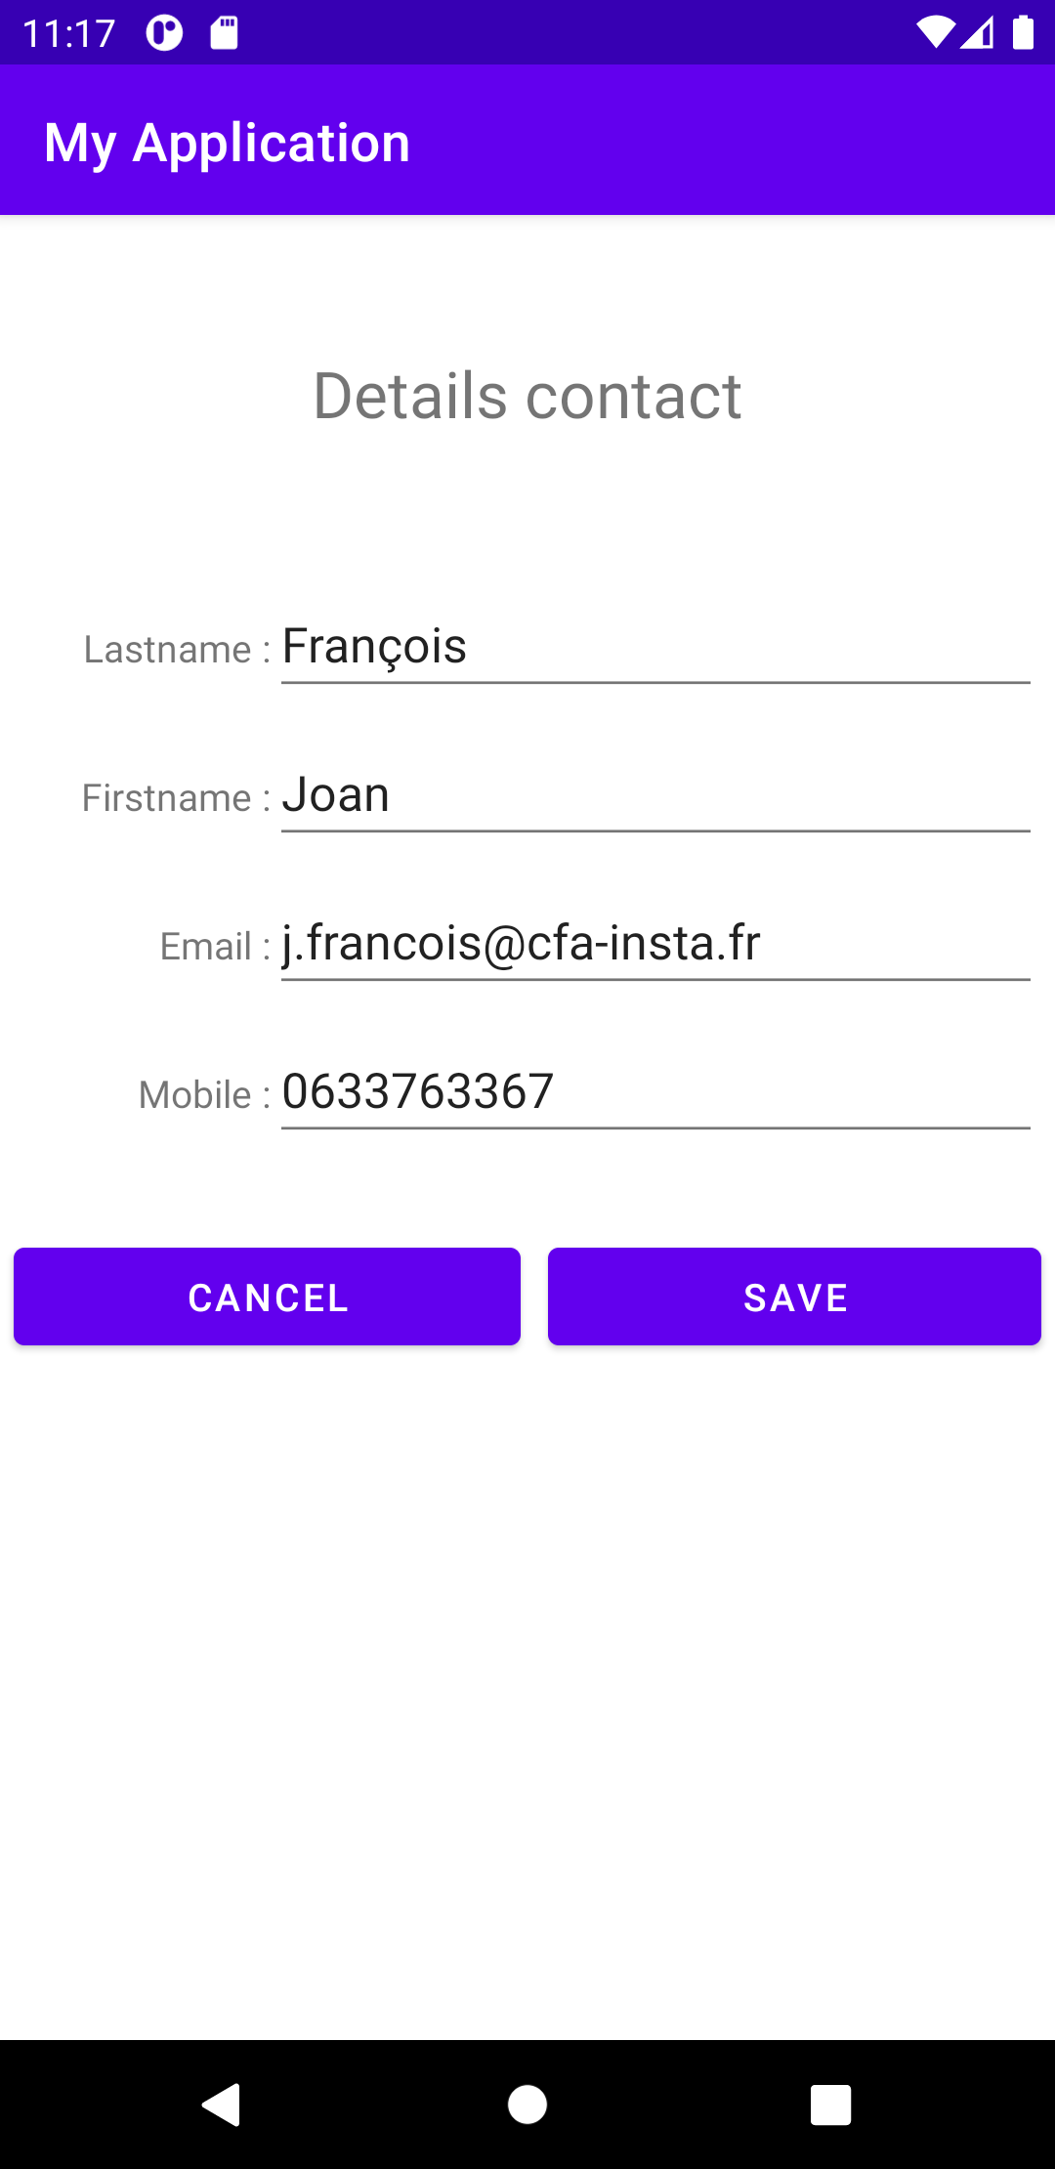
Application contact
Reprendre l’application contact vu en cours.
Renommer l’activité “MainActivity” en “ContactActivity”
Renommer le layout activity_main en activity_contact
Créer une nouvelle activité “MainActivity” et le layout associé (voir page suivante).
Relier le tout par des intents.
Sérialiser les contacts et les sauvegarder en Sharedpreferences.

Slide 21
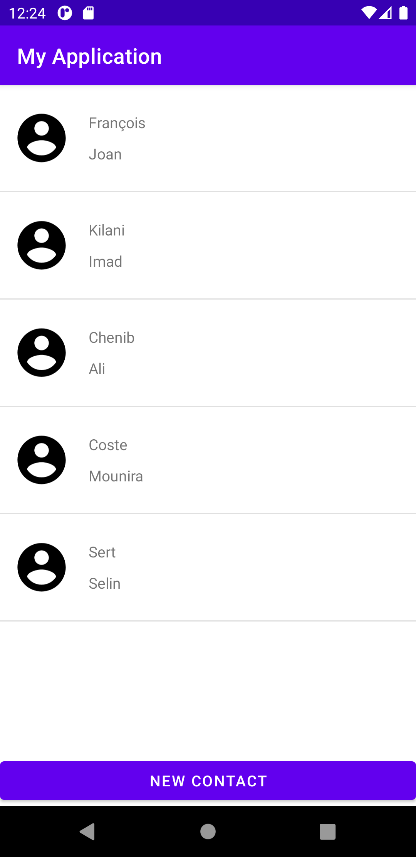
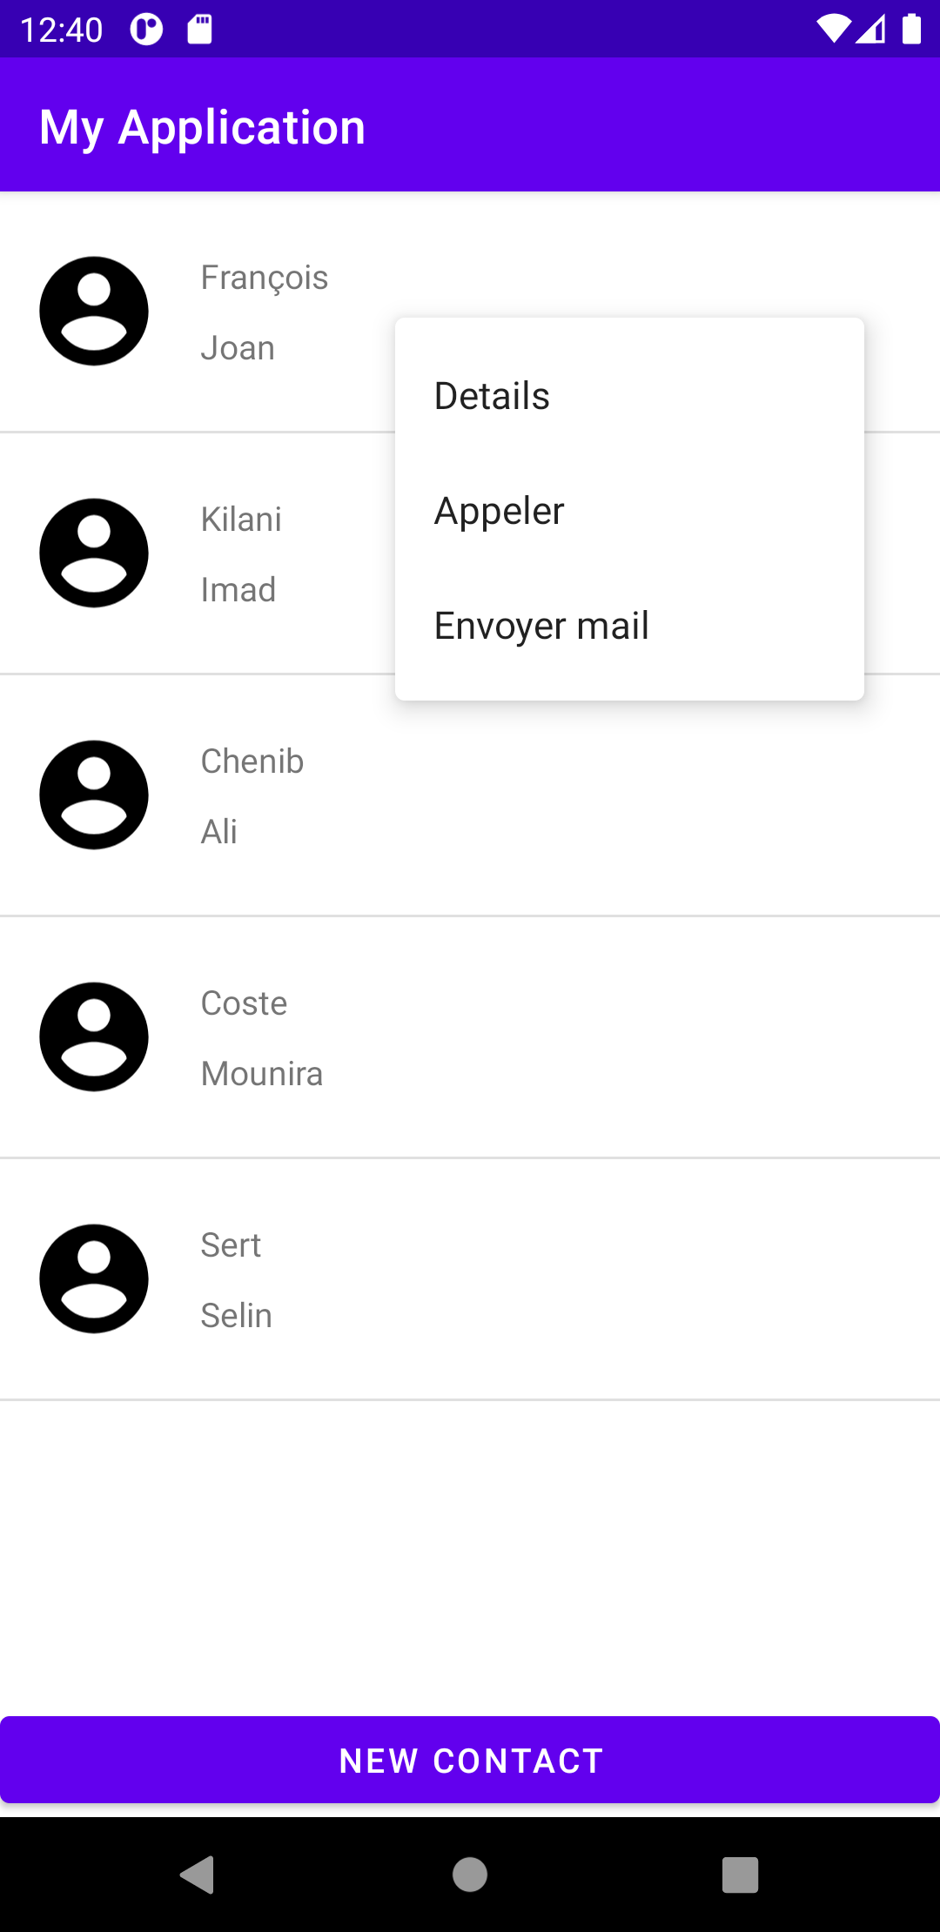
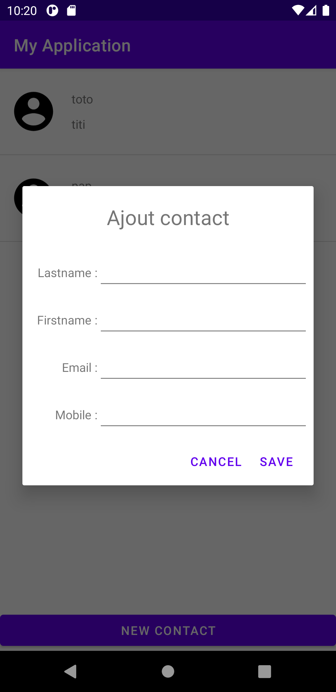
Application contact
Notes:
https://guides.codepath.com/android/Using-a-BaseAdapter-with-ListView

Slide 22
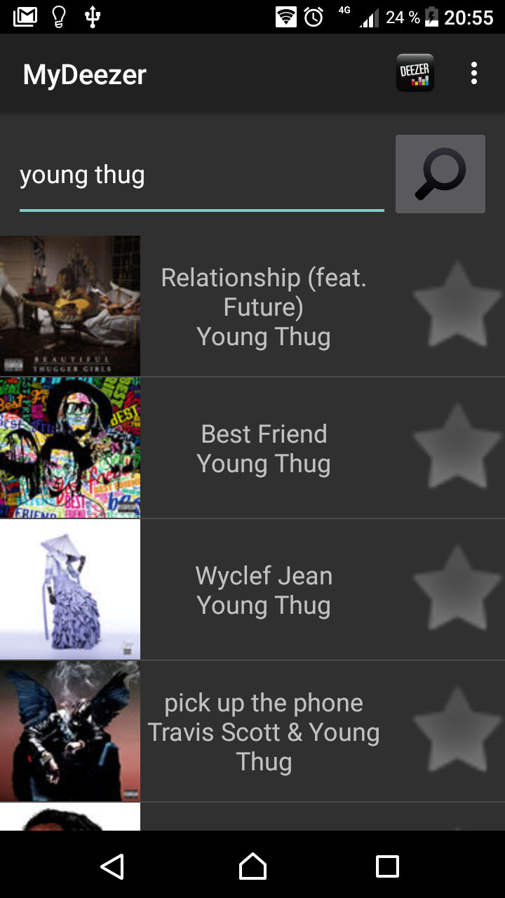
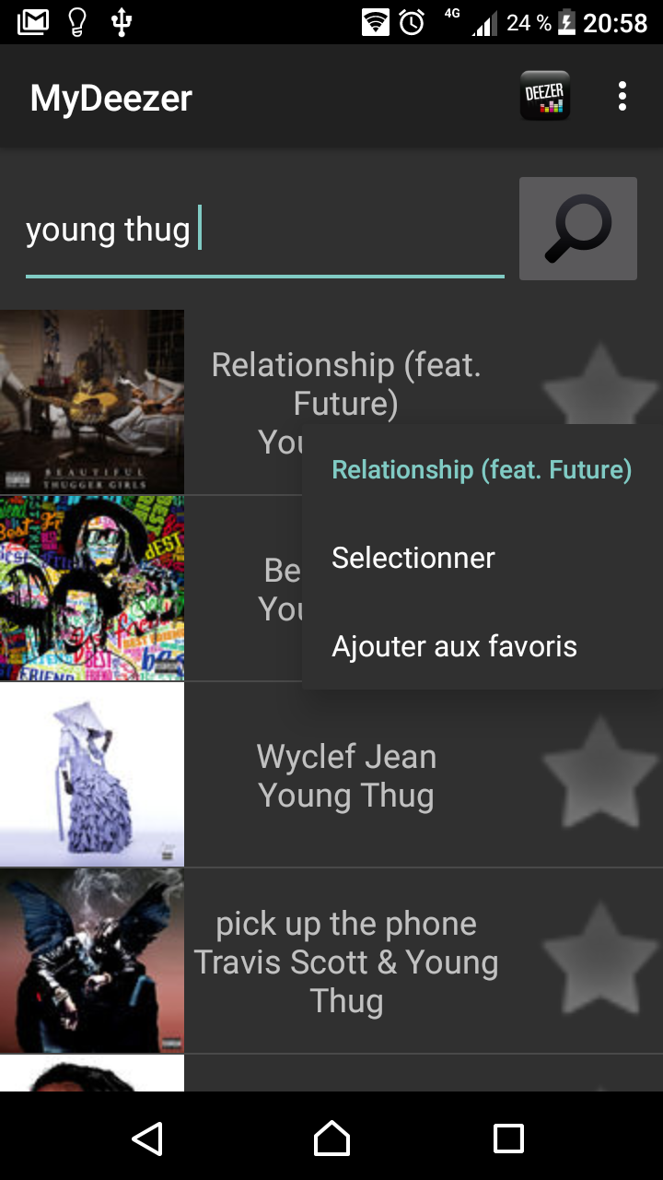
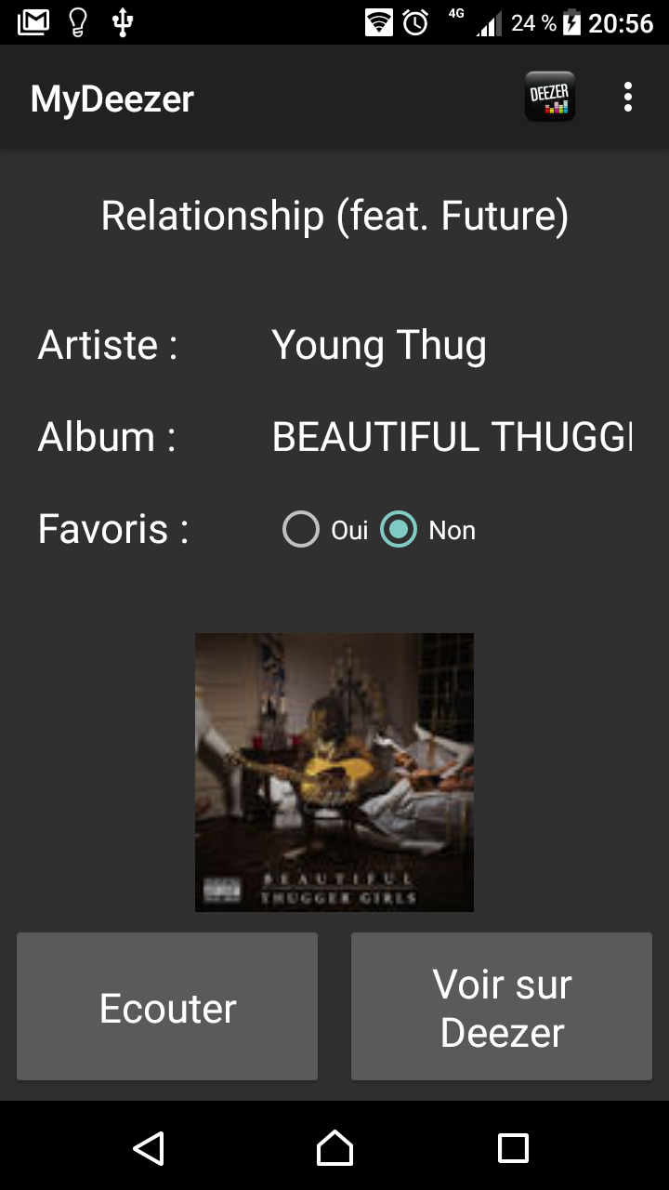
Application MyDeezer

